Slide 1
SPEECH RECOGNITION
Project Guide- Mrs. D.Sri Lakshmi M.Tech Assistant Professor
presented by
Krishna kumari- N140554
Meena - N140279
Vijaya-N140505

Slide 2
Introduction
Speech recognition is the process of converting speech into text form.
The main purpose of choosing this project is
Nearly 30% people of the world are suffering from various disabilities, many of them are blind or unable to use their hands effectively .
By using the speech recognition systems in those particular cases we provide a significant help to them ,so that they can operate computer through voice input.
This project is designed and developed keeping that factor into mind and a little effort is made to achieve this aim.

Slide 3
Past System
In the 1960’s we were able to recognize small vocabularies (order of 10-100words) of isolated words.
In 1970s the medium vocabularies (order of 100-1000 words) using simple template-based, pattern recognition methods were recognized.
In past systems,system monitoring is not existed and there is no concept of providing security to the given speech.

Slide 4
EXISTING SYSTEM
After the five decades of research, the speech recognition technology has finally entered marketplace, benefiting the users in variety of ways.
The challenge of designing a machine that truly functions like an intelligent human is still a major one going forward.
In this we added extra features such as system monitoring and providing security.
FUTURE ENHANCEMENT:
In future we can implement this project as an application with 99% accuracy.

Slide 5
TECHNOLOGIES
Presently python is trending programming language so we have chosen the project in this area.
In this project the main platform we are going to use is python 3.6.0.
Why we have chosen python language is it is a platform independent language and it has many inbuilt packages to implement our project.

Slide 6
SYSTEM REQUIREMENTS FOR THE PROJECT
Hardware Requirements
Windows 10
2GB of RAM
Microphone
Sound cards
Pentium 200 MHz processor
Software Requirements
Python 3.6.0
Pip tool 9.0.1

Slide 7
STEPS FOR IMPLEMENTING THE PROJECT
Initially install python 3.6.0
Install pip tool
Import speech recognition package
Import os package
Programming for the system monitoring
Programming for providing the security
Final Output

Slide 8
Initially install python 3.6.0
It is a general-purpose programming language typically used for developing software’s.
To install it we use http://www.python.org
To install pip tool 9.0.1
Pip tool contains inbuilt packages such as:
PyAudio
PortAudio
To install it we use http://bootstrap.pypa.io/get-pip.py

Slide 9
Import Speech Recognition
It is used for speech recognition purpose.
This package supports several engines and API’s in online.
In this project we use Google API
To import speech recognition package using command prompt:
Command: pip install SpeechRecogntion
By importing Speech Recognition package we use Recognizer class,
Recognizer() is a recognizer instance and it contains several
functionalities for recognizing speech from an audio source.
For creating Recognizer instance:speech_recognition.Recognizer()
recognize_google(audio): Google web speech API

Slide 10
Import os package
This package is used for system monitoring
we can monitor the system by importing the os Library and it’s startfile() function to access particular resource.
os.startfile():
It is a method allow us to “start” a file with its associated program.In this associated program we provide the path to the corresponding requirements.

Slide 11
Programming for system monitoring
We implement the program to monitor the system by using
os.startfile method.So we can access any resource through
voice as a input like opening files,folders,audio files,video
files,images,softwares etc.
Programming for providing security
For providing security we used one of the poly alphabetic cipher technique,i.e Auto keycipher.
Compared to other cipher techniques it is more secure and reliable.

Slide 12
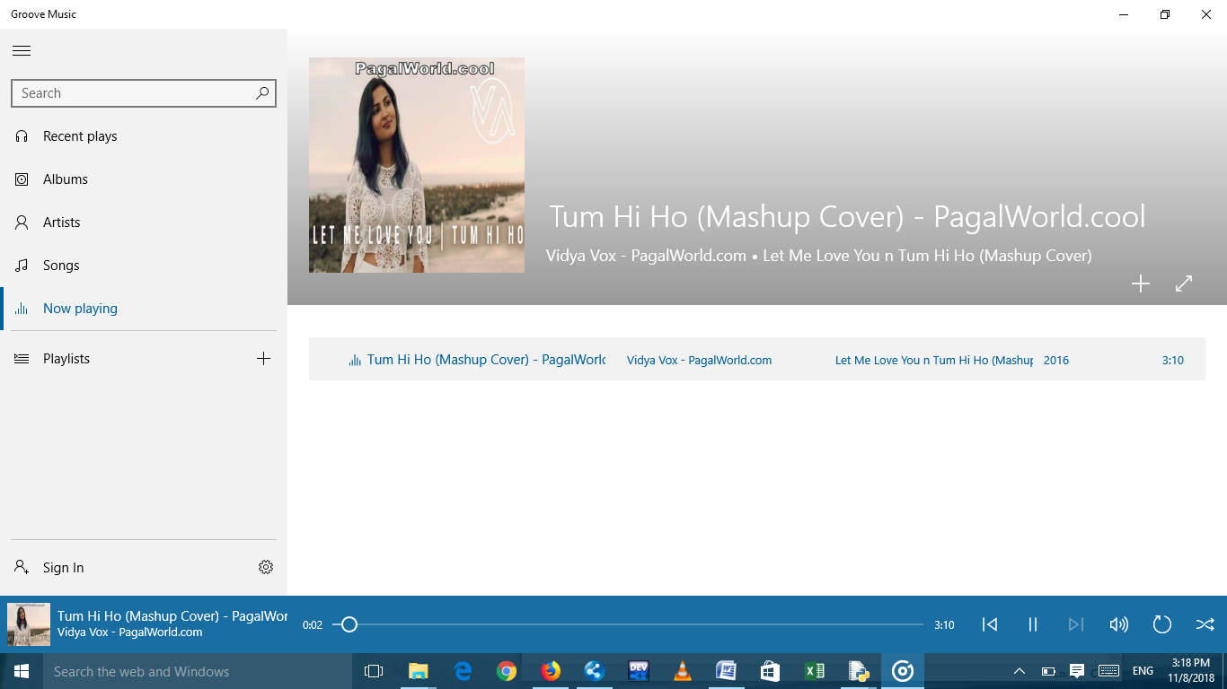
Final Output
It will successfully monitor the system according to the given speech.
To open music file:

Slide 13
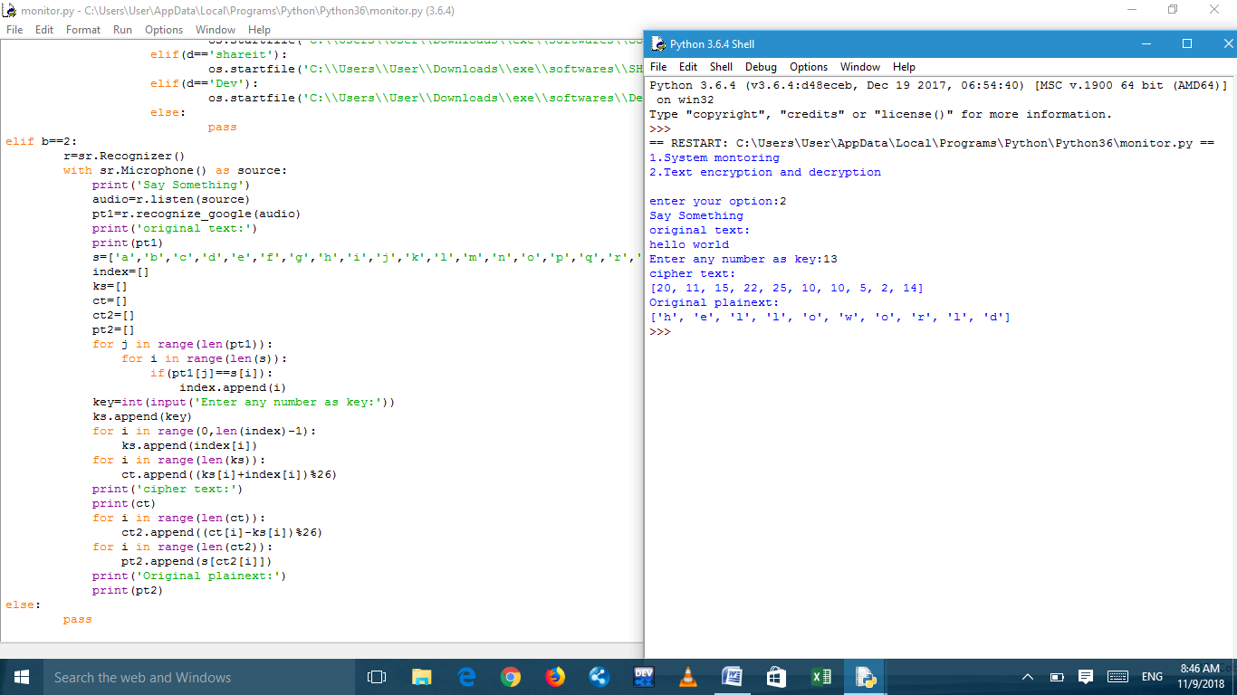
We will successfully obtain the original plaintext as we spoken initially.
Out put for system security

Slide 14
ADVANTAGES
Advantages of System monitoring through speech recognition:
It will reduce the time cost
To overcome keypad problems ,instead of using keypad we use speech recognition
It will helpful for people who have disabilities to use the system they can use this project to monitor the system.
Advantages of providing security to the given text obtained from the speech:
No one can modify the data while transmitting data from sender to receiver.
It is one of the efficient technology in polyalphabetic cipher because it is difficult for attackers to identify the letters for modifying purpose.

Slide 15
DISADVANTAGES
Low accuracy
Not good in the noisy environment.
Incorrect pronounciation

Slide 16
THANK YOU

